Slide 1
ML Downfolding VQE

Slide 2
Basis Set Should Match Algorithm
Accuracy
...
Wave Function Theory:
CC, MP, FCI etc
cc-pVTZ, def2-TZVP
cc-pVDZ, def2-SVP
Mean Field Theory:
HF, DFT etc
Sto-3G
https://sites.google.com/site/orcainputlibrary/basis-sets?authuser=0

Slide 3
Mismatch of VQE
Standard VQE setting [1]:
Sto-3G + UCCSD ansatz
Accuracy
...
Wave Function Theory:
CC, MP, FCI etc
cc-pVTZ, def2-TZVP
cc-pVDZ, def2-SVP
Mean Field Theory:
HF, DFT etc
Sto-3G
[1] McArdle, Sam, et al. "Quantum computational chemistry." Reviews of Modern Physics 92.1 (2020): 015003.

Slide 4
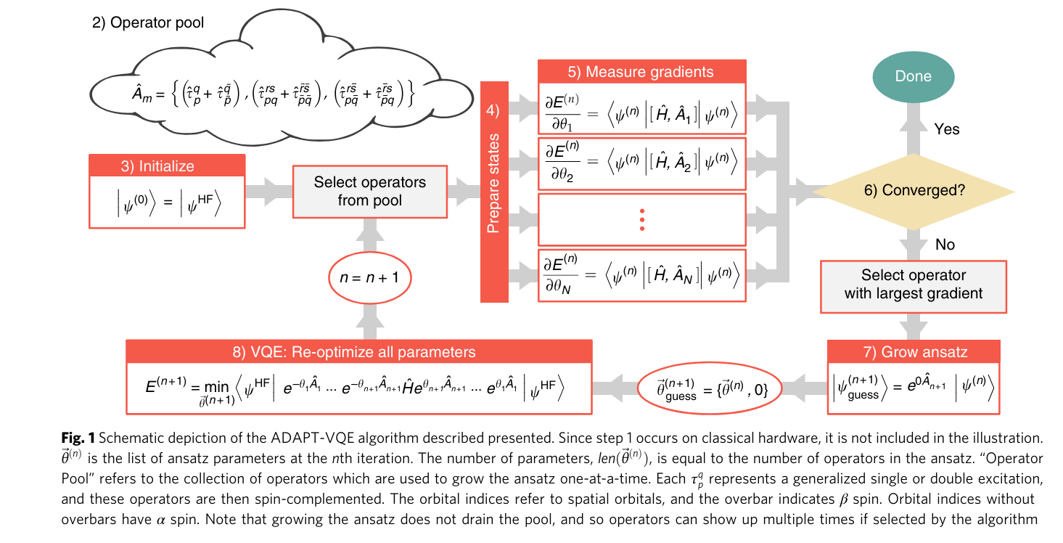
ADAPT-VQE
We use ADAPT-VQE + UCCSD ansatz in this work
UCCSD accuracy, faster convergence
[2] Grimsley, Harper R., et al. "An adaptive variational algorithm for exact molecular simulations on a quantum computer." Nature communications 10.1 (2019): 3007.

Slide 5
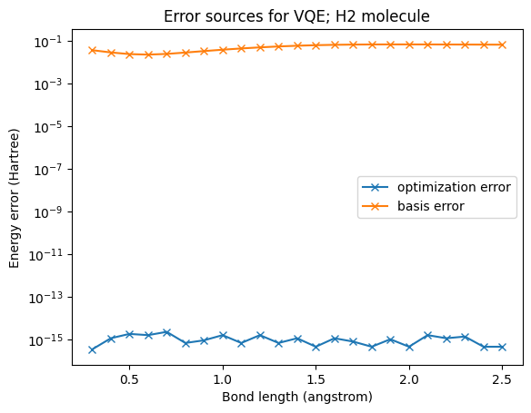
Mismatch: Numerical Evidence
Basis error can be much larger than optimization error

Slide 6
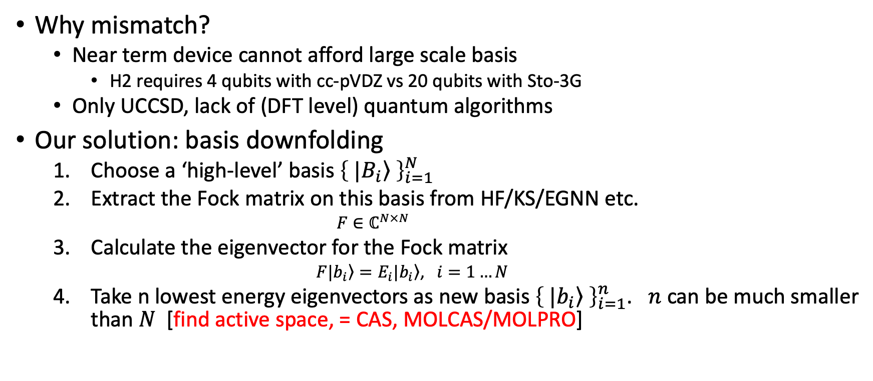
Our Solution: Basis Downfolding

Slide 7
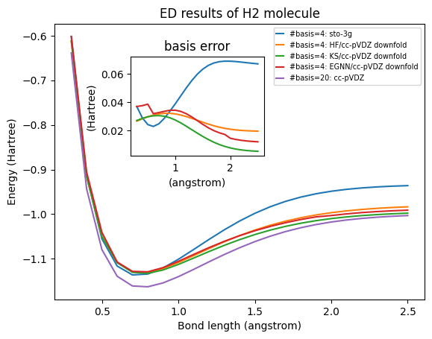
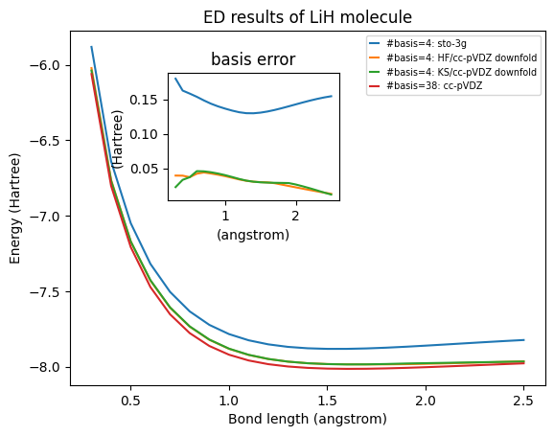
Results of basis downfolding
[TBD: discontinuous=cut-off in NN]
[TBD: downfold with cc-pVTZ]

Slide 8
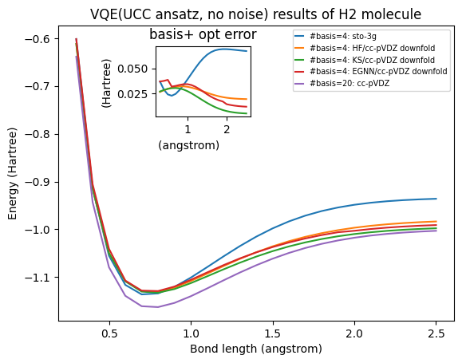
Test on Qiskit Emulator
[TBD: LiH result]

Slide 9
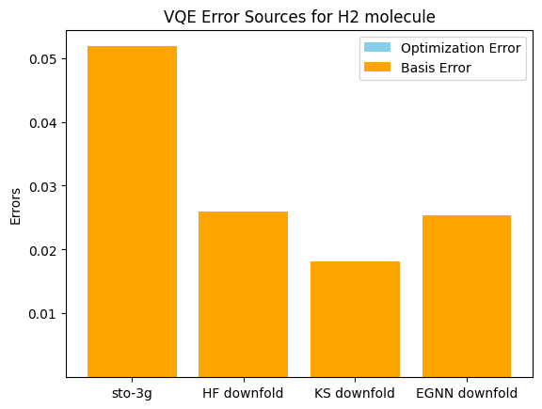
VQE Error Sources Identification
Basis error compressed
[TBD: LiH result]
Average from 0.3 to 2.5 Angstrom

Slide 10
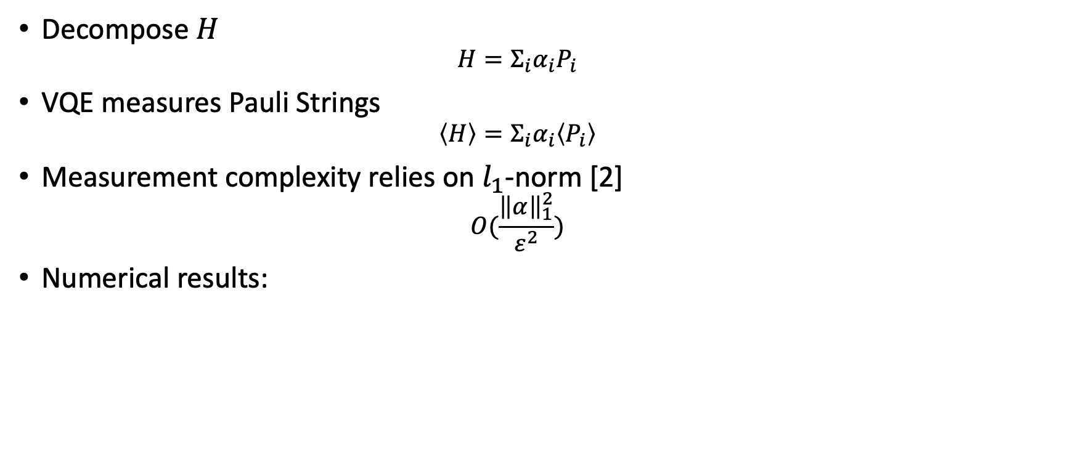
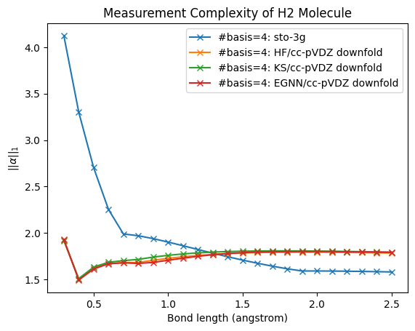
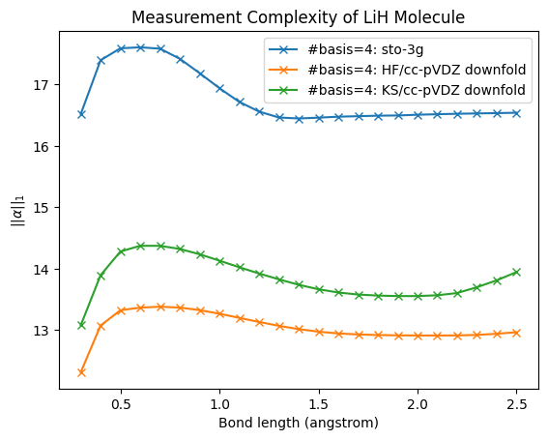
Measurement Complexity
[explanation?]
[2] Wu, Bujiao, et al. "Overlapped grouping measurement: A unified framework for measuring quantum states." Quantum 7 (2023): 896.

Slide 11
Discussion
Hybrid method: classical computer for better basis
Higher accuracy for limited qubits
connect ML with VQE

Slide 12
Related Literature
[3] and [4] propose hybrid VQE algorithms with the classical part doing unitary basis transformation. Their works do not discuss basis error. Our downfolding method is unitary+projection instead of pure unitary.
Some VQE papers take Sto-3G Hamiltonian as ‘exact’ Hamiltonian and simply neglect basis error [5][6].
[3] Shang, Zhong-Xia, et al. "Schrödinger-Heisenberg variational quantum algorithms." Physical Review Letters 131.6 (2023): 060406.
[4] Huang, Junxiang, et al. "Tensor-network-assisted variational quantum algorithm." Physical Review A 108.5 (2023): 052407.
[5] Kandala, Abhinav, et al. "Hardware-efficient variational quantum eigensolver for small molecules and quantum magnets." nature 549.7671 (2017): 242-246.
[6] Kandala, Abhinav, et al. "Error mitigation extends the computational reach of a noisy quantum processor." Nature 567.7749 (2019): 491-495.

Slide 13
Examples
CO, H2O, LiH,
train new EGNN, add Li etc

Slide 14
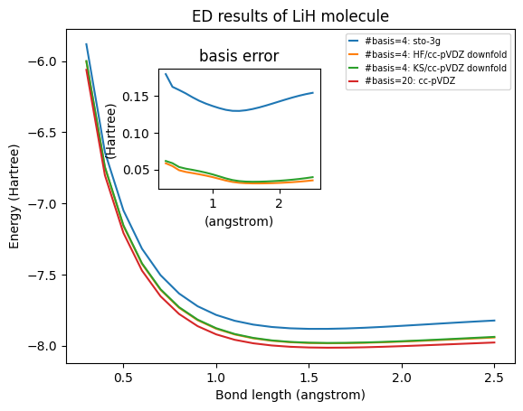
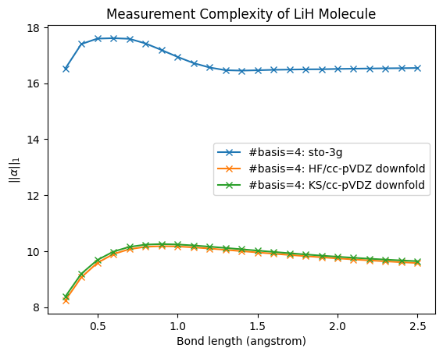
Explanation?
when I set n=2 (4 in total with spin), still get very good result with very low measurement complexity

Slide 15
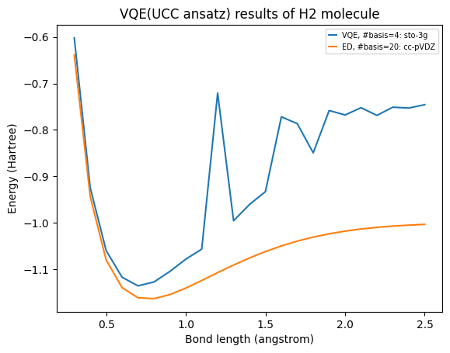
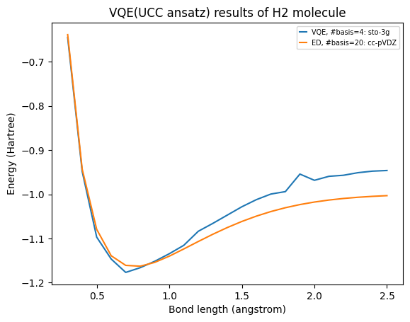
new VQE results
new results have no spike

Slide 16
https://github.com/He-Wenhao/VQE_downfold

